Slide 1
Digital Portfolio
STUDENT NAME: DHARANI.D
REGISTER NO AND NMID: 21024u09015&9BA25BE8202282DAAD3427D9BC005B55
DEPARTMENT: DEPARTMENT OF COMPUTER APPLICATION-(BCA)
COLLEGE: SRI AKILANDESWARI WOMEN'S COLLEGE,VANDAVASI/THIRUVALLUVAR UNIVERSITY.

Slide 2
PROJECT TITLE
Student Digital Portfolio Using
Front End Development

Slide 3


AGENDA
Problem Statement
Project Overview
End Users
Tools and Technologies
Portfolio design and Layout
Features and Functionality
Results and Screenshots
Conclusion
Github Link
3/21/2024 Annual Review

Slide 4

PROBLEM STATEMENT
Needs: Students become skilled and job-ready. It improves employment and contributes to national growth. Impact: To prepare students for the job market. To guide youth in career and skill development. To raise the standard of living and support future dreams.

Slide 5

PROJECT OVERVIEW
1. Launched by the Government of Tamil Nadu for students’ skill development. 2. Provides training in technical, communication, and soft skills. 3. Offers career guidance and opportunities in emerging fields like IT, AI, healthcare. 4. Helps students become job-ready, confident, and contribute to national growth .

Slide 6

WHO ARE THE END USERS?
1. School Students – to get career guidance and basic skill training. 2. College / University Students – to improve employability and industry-ready skills. 3. Youth seeking jobs – to gain additional training and job opportunities. 4. Employers / Companies (indirectly) – they get skilled, trained candidates for jobs.

Slide 7

TOOLS AND TECHNIQUES
1. Digital Platforms / Online Portals – For registration and e-learning. 2. Learning Management Systems (LMS) – To provide online courses and lessons. 3. Workshops & Seminars – For practical learning in schools and colleges. 4. Industry Tie-ups & Internships – Real work exposure through companies. 5. Assessments & Certifications – Tests and certificates to validate skills.

Slide 8
POTFOLIO DESIGN AND LAYOUT
1. Cover Page – Name, title, and basic details. 2. Table of Contents – Easy navigation of sections. 3. Introduction – About yourself or project purpose. 4. Main Content – Skills, achievements, and project details. 5. Design & Consistency – Neat layout, clear fonts, and uniform style.
6. Consistency – Maintain the same style, color, font, and formatting throughout the portfolio. 7. Conclusion / References – Add a summary, acknowledgments, or list of sources used.
8

Slide 9
FEATURES AND FUNCTIONALITY
1. User-Friendly Design – Easy to use and navigate. 2. Accessibility – Available through web or mobile platforms. 3. Interactive Modules – Videos, quizzes, and practice tasks. 4. Customization – Users can update personal details or choose courses. 5. Data Management – Stores and tracks progress, scores, and certificates. 6. Security – Protects user information and login details. 7. Integration – Connects with industry, companies, and training partners.

Slide 10
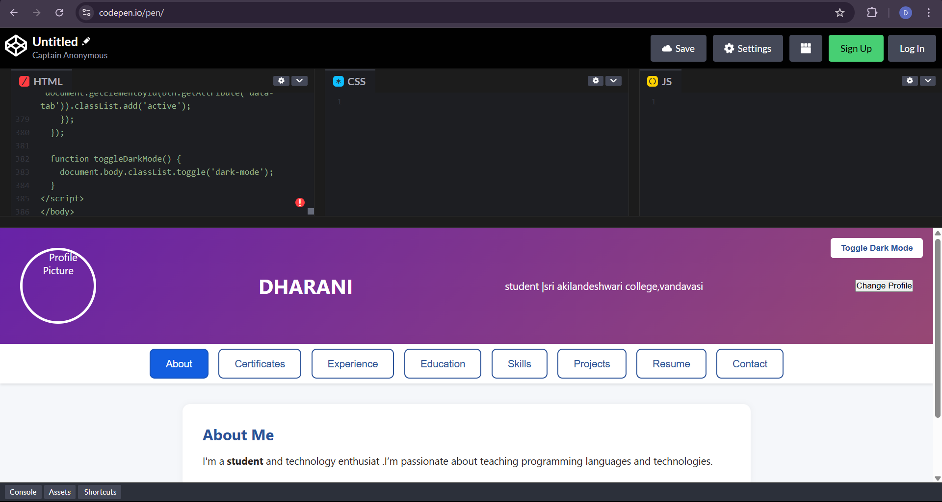

RESULTS AND SCREENSHOTS
3/21/2024 Annual Review
10

Slide 11
CONCLUSION
The project is part of the Naan Mudhalvan scheme.It focuses on building a student digital portfolio.The portfolio is designed using Front End Development.Technologies like HTML, CSS, and JavaScript are used.Students can showcase their skills and achievements.It helps in creating a professional online identity. The project improves technical and creative skills. It also enhances presentation and communication.Employers can easily view student talents and profiles.Thus, the project makes students confident and job-ready.
11

